Slide 1
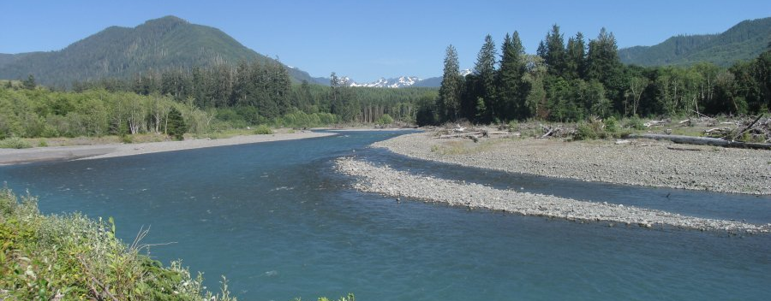
Watershed Hydrology & Sediment Dynamics
Sediment Transport in Stream Assessment and Design
August 2, 2021
Patrick Belmont
“It is hard to imagine that a transport estimate made in the absence of a sound understanding of watershed history and dynamics would be of much use at all.”
Notes:
Prelim questions:
How many are interested in coarse (bed) sediment? How many interested in fine sediment?

Slide 2
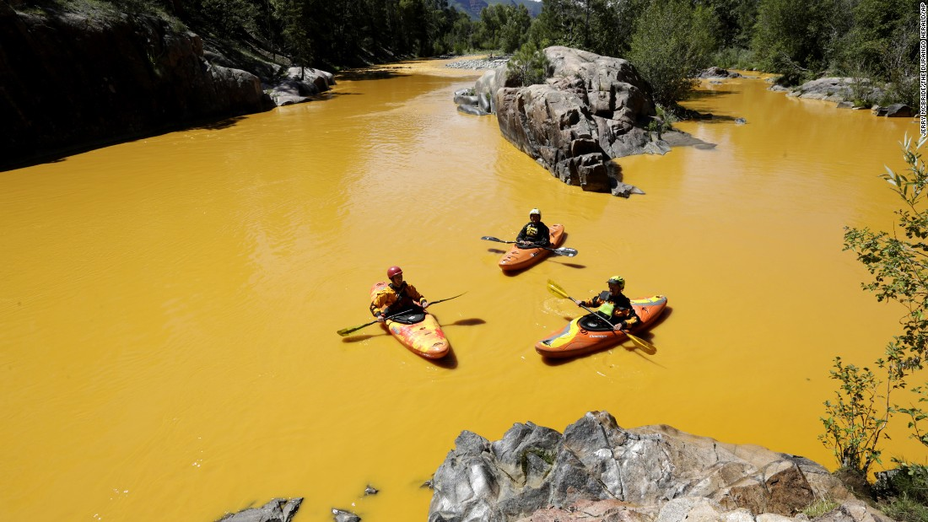
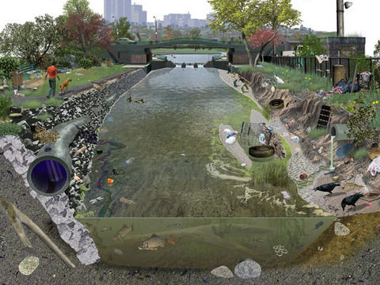
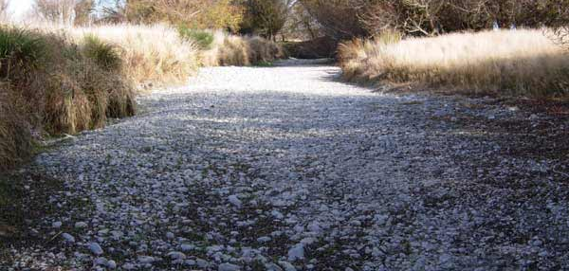
Have hydrology and/or sediment supply
‘changed’ substantially over time?
How much and what type of sediment
is being delivered to this channel?
How to describe the distinct reaches and
how sensitive are they to change in Q, Q_{s}?

Slide 3
A few key messages up front…
In many cases, all that is needed/feasible is to know if supply is a big # or small #
Measuring channel behavior, morphology and bed characteristics will inform your
understanding of ‘sensitivity’
Sometimes you need numbers, but good numbers don’t come easy
Spatial and temporal variability over wide range of scales, Interactions of
many non-linear processes
Develop conceptual model of reach types, sources, sinks, connectivity…
…then measure/model key rates
Multiple independent and semi-redundant estimates often needed
May need to know locations, mechanisms, and rates of erosion and deposition
Size matters…boulders, cobbles, gravel, sand, mud play distinct roles
Models can be useful and/or misleading
Examine and consider implications of hydrologic non-stationarity
Many new tools available, none are comprehensive or bullet-proof

Slide 4
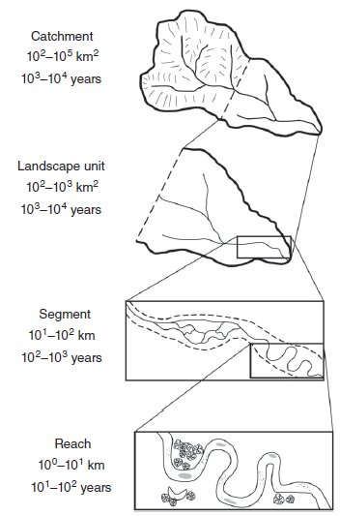
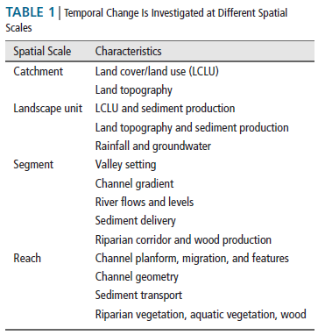
Watershed analysis and reach typing
Grabowski et al. 2014

Slide 5
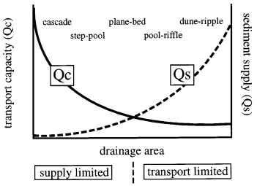
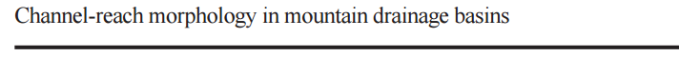
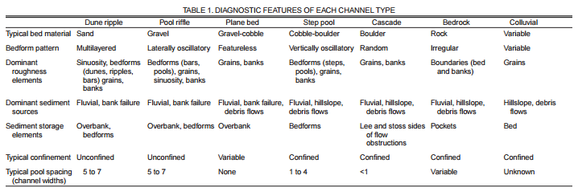
Less confined, alluvial reach types have more modes of adjustment
Montgomery and Buffington, 1997

Slide 6
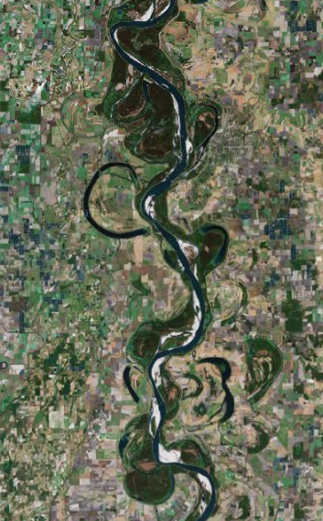
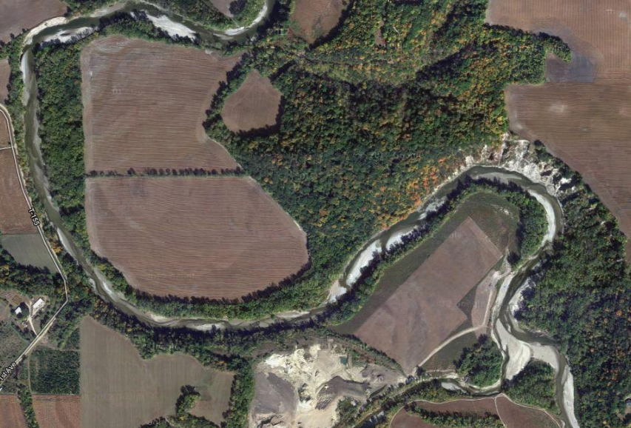
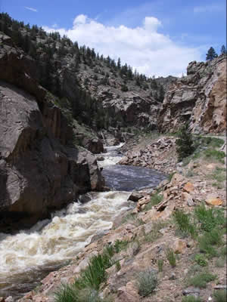
Valley confinement
Partly Confined
90-50%: margin controlled
10-40%: planform controlled
Confined
>90% interacting with confining margins
Unconfined
<10% interacting with cm

Slide 7
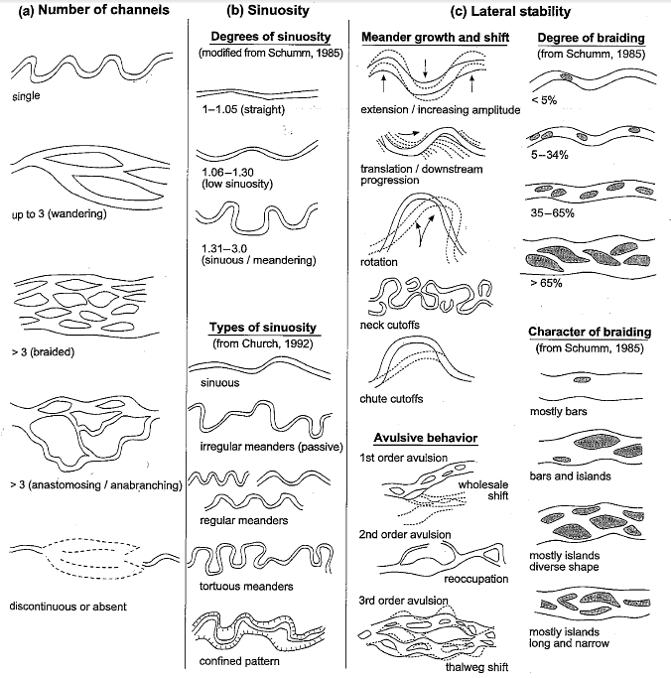
Metrics of
channel
planform

Slide 8
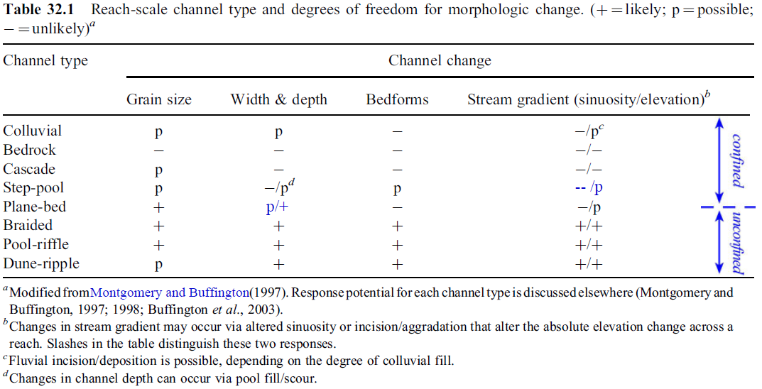
Modes of adjustment vary considerably
for different river types

Slide 9
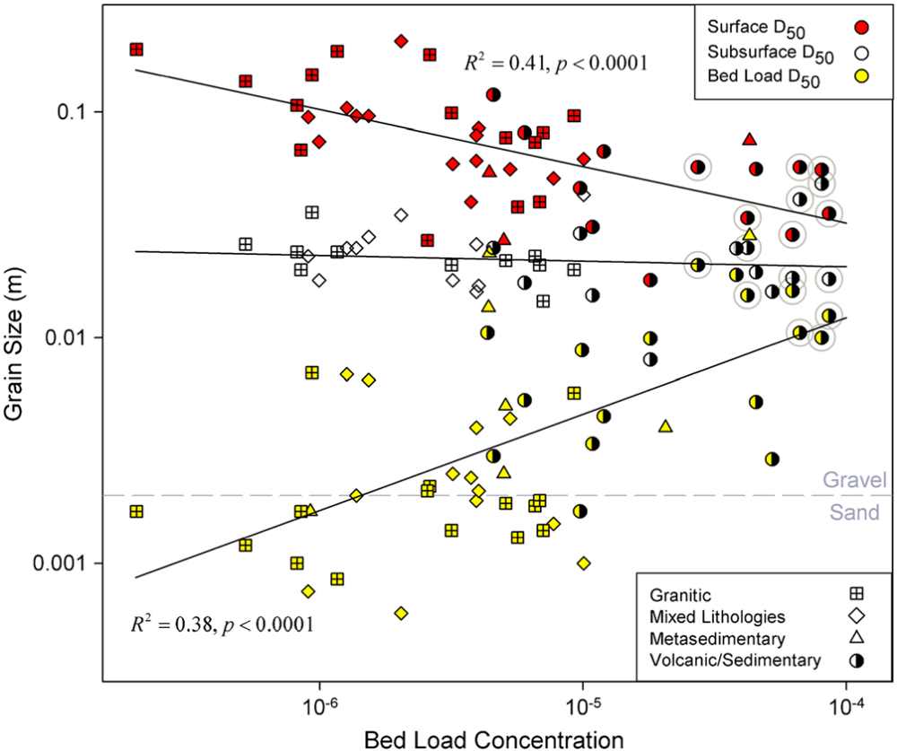
Armoring indicates low sediment supply
Mueller and Pitlick, 2013

